Slide 1
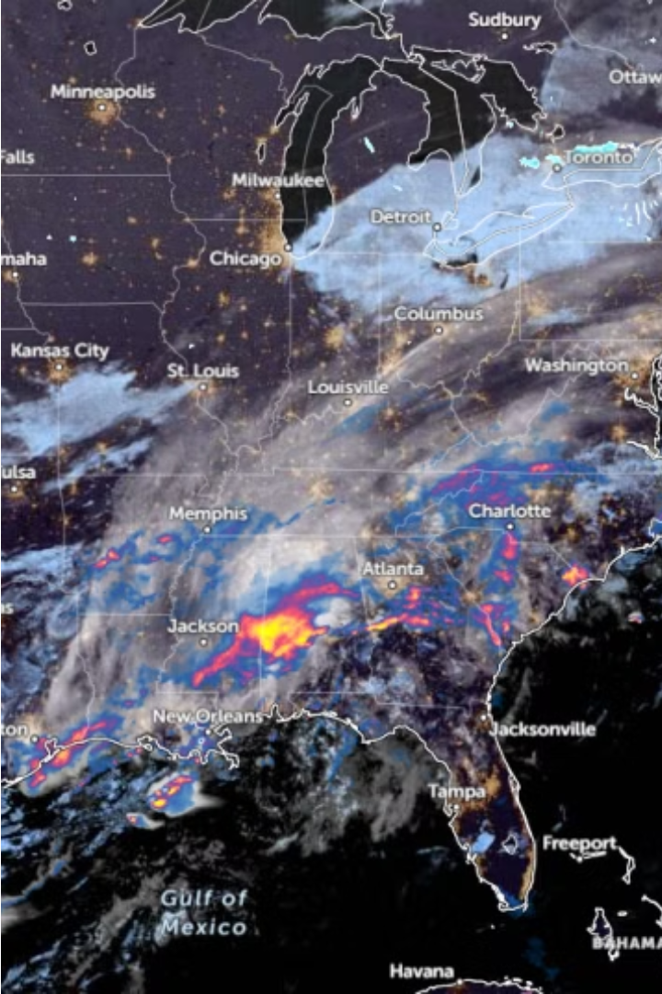

Introduction to Weather Image Recognition
Dive into the fascinating world of weather image recognition, where advanced artificial intelligence algorithms analyze visual data to predict and monitor atmospheric conditions.
Made by:
Ahmed Mostafa Attia
Adel Mamoun
Nadin Ahmed
Hadeer Abdelhady
Nawal Abdelmoniem

Slide 2
Overview of Deep Learning
Powerful Algorithms
Adaptable Models
Deep learning utilizes complex neural network architectures to tackle challenging problems with remarkable accuracy.
These models can learn directly from data, adapting and improving their performance over time.
Diverse Applications
Hardware Acceleration
Deep learning has revolutionized fields like computer vision, natural language processing, and predictive analytics.
Powerful GPUs and specialized hardware have enabled the efficient training and deployment of deep learning models.

Slide 3
Dataset Preparation
Curate a comprehensive dataset of weather-related images, including various weather conditions such as sunny, rainy, cloudy, and snowy scenes.
Ensure the dataset covers a diverse range of geographical locations, time of day, and weather intensities to capture the breadth of real-world scenarios.
Preprocess the images by resizing, normalizing pixel values, and converting to a format suitable for deep learning models, such as 3-channel RGB images.

Slide 4
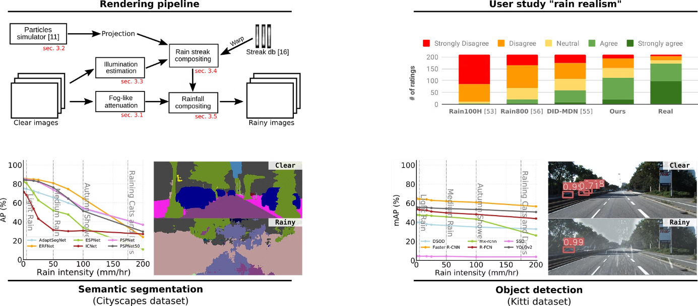
.Data Augmentation Techniques

Slide 5
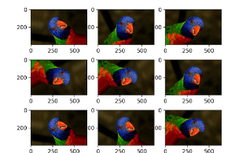
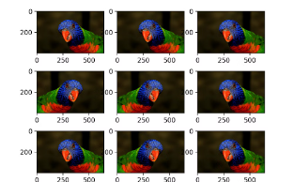

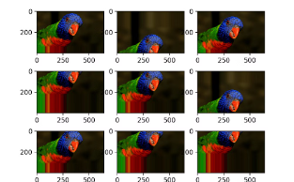
Data Augmentation Techniques
Image Rotation
Horizontal Flip
Random Cropping
Color Jittering
Randomly rotating images within a specified angle range .
Flipping images horizontally doubles the size of the dataset
Extracting random crops from images for improving generalization.
Applying random adjustments to brightness, contrast, saturation, and hue

Slide 6
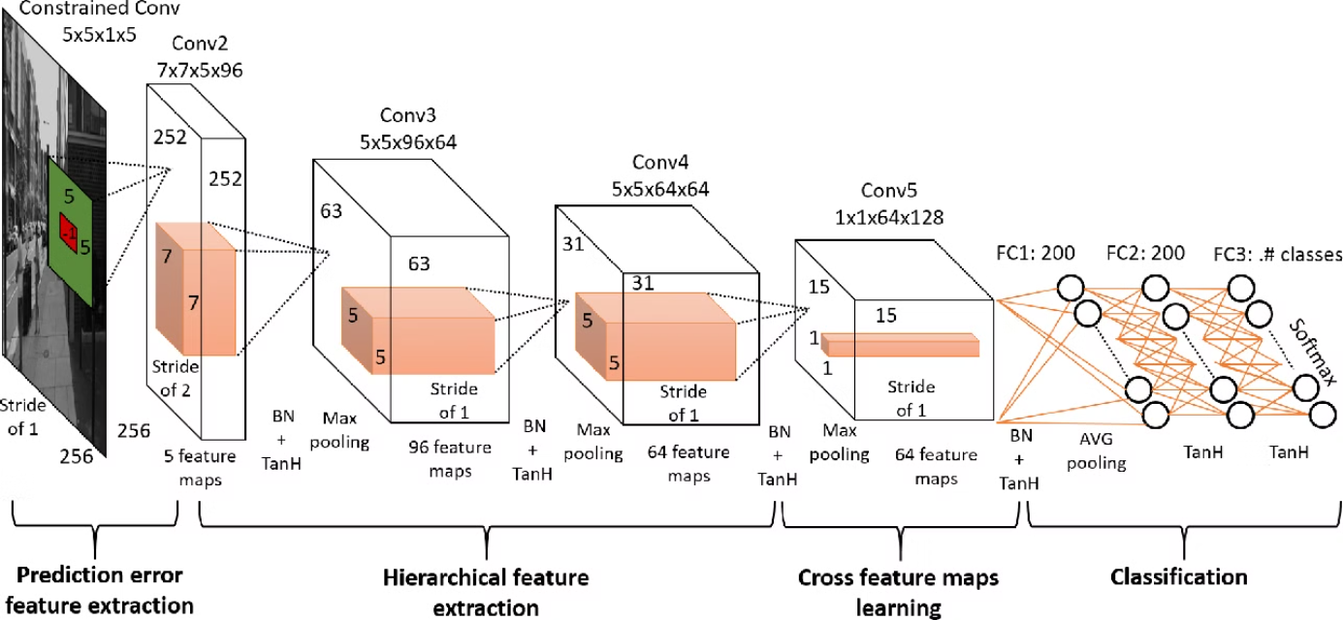
Generic CNN Arch

Slide 7
Convolutional Neural Network Architecture
Convolution Layers
Pooling Layers
Fully Connected Layers
Activation Functions
Pooling layers follow the convolution layers, reducing the spatial size of the feature maps and making the model more robust to small translations in the input.
The core of a CNN is a series of convolution layers that extract visual features from the input image. These layers apply learnable filters to detect edges, shapes, and patterns in the data.
After the convolutional and pooling layers, the network flattens the feature maps and connects them to one or more fully connected layers. These layers perform high-level reasoning and classification.
Non-linear activation functions, such as ReLU, are applied to the outputs of the convolution and fully connected layers, Softmax converts raw output scores into class probabilities, aiding interpretation.

Slide 8

Transfer Learning for Weather Image Recognition
Transfer learning is a powerful technique in deep learning, allowing us to leverage pre-trained models and adapt them to weather image recognition tasks. This approach can significantly reduce the amount of training data and computation required, making it an efficient solution for practical applications.
Models used : VGG16 , ResNet50 , EfficientNetB3

Slide 9
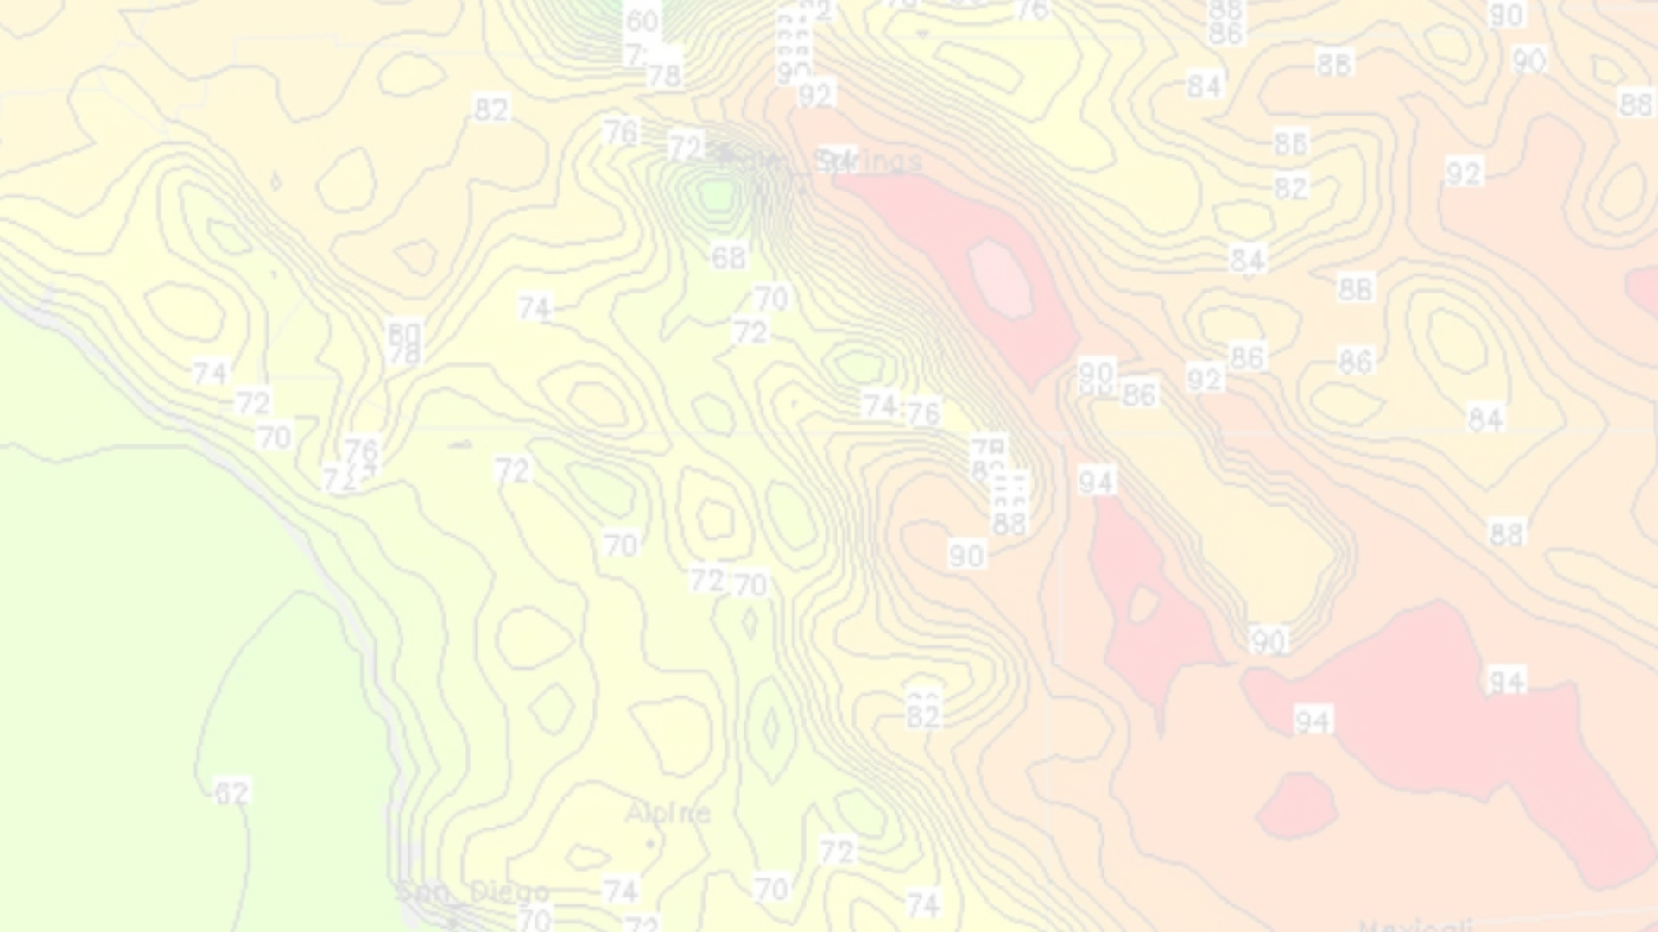
Training and Validation Strategies
Splitting the Dataset
1
Divide the dataset into training, validation, and test sets to effectively evaluate model performance.
2
Early Stopping
Monitor validation metrics during training and stop when performance stops improving to prevent overfitting.
Batch Normalization
3
Technique to stabilize and speed up deep neural network training.
4
Dropout
Addresses internal covariate shift and improves convergence.
Technique used in training deep neural networks to improve generalization and robustness.
Addresses overfitting by randomly dropping units (neurons) during training

Slide 10
Hyperparameter Tuning
1
Identifying Key Hyperparameters
2
Validation and Monitoring
Determine the most influential hyperparameters for your deep learning model, such as learning rate, batch size, and number of layers.
Use a validation set to evaluate model performance during hyperparameter tuning and monitor metrics like accuracy, loss, and convergence.
3
Early Stopping
Implement early stopping to avoid overfitting.

Slide 11
Model Evaluation and Metrics
Evaluating the performance of the weather image recognition model is crucial to ensure its effectiveness. Key metrics like accuracy, precision, recall, and F1-score will be calculated to assess the model's ability to correctly classify weather conditions.
Metric
Description
Accuracy
The overall proportion of correct predictions out of the total number of predictions.
Precision
The ratio of true positive predictions to the total number of positive predictions.
Recall
The ratio of true positive predictions to the total number of actual positive instances.
F1-score
The harmonic mean of precision and recall, providing a balanced measure of model performance.
These metrics will be calculated on both the validation and test datasets to ensure the model's generalization capability and robustness in real-world scenarios.

Slide 12
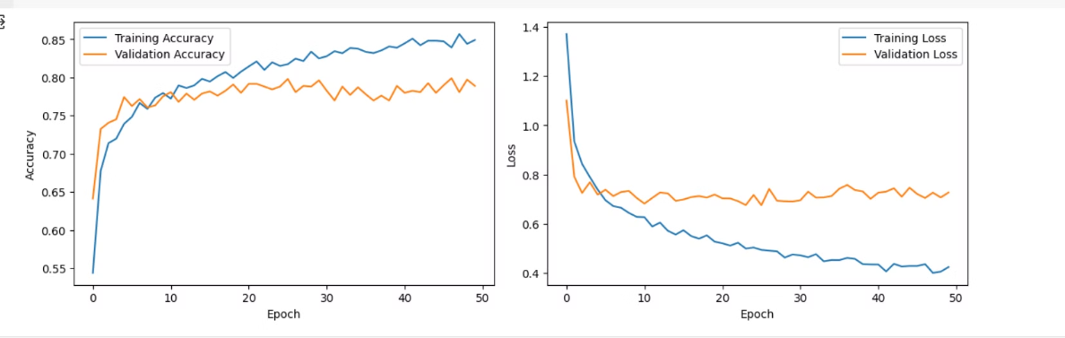
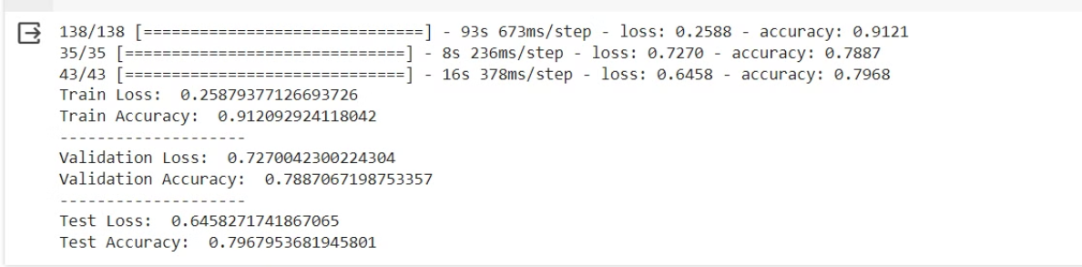
Accuracy vs Loss

Slide 13

Deployment Video

Slide 14
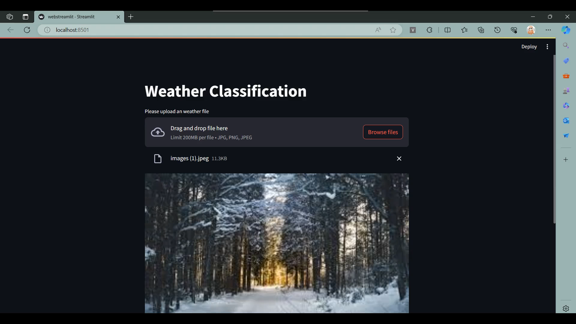

Slide 15

Conclusion and Future Directions
In conclusion, this deep learning project on weather image recognition has demonstrated the power of convolutional neural networks in accurately classifying various weather conditions.
Looking to the future, there are exciting opportunities to further enhance the weather recognition system. Integrating real-time sensor data, exploring transfer learning from large-scale datasets, and investigating the use of advanced architectures like attention-based models could lead to even more accurate and reliable weather prediction capabilities.
Batch Normalization is a powerful technique for improving deep learning model stability and performance.

Slide 16
Thank you.

